Slide 1
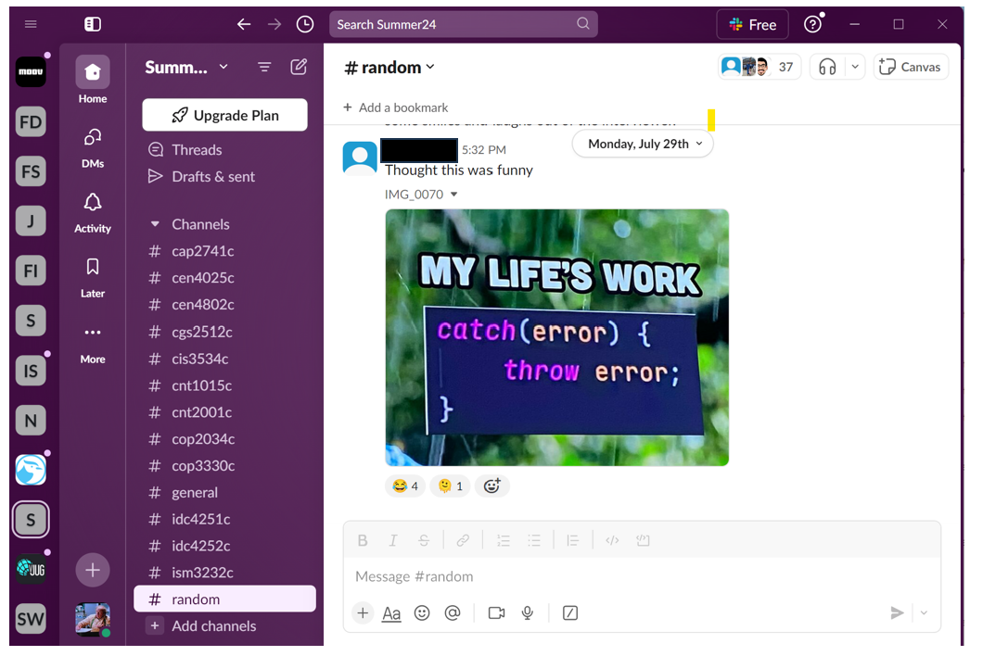
Leveraging Slack for Student Collaboration
David Singletary David.Singletary@fscj.edu
Pamela Brauda Pamela.Brauda@fscj.edu
Student Presenters:
Kathryn Arraya (A.S. Data Science Technology)
Steven Gsell (B.A.S. Information Systems Technology, Application Development Concentration)

Slide 2

Where to Find These Slides

Slide 3
Why Slack
Gartner: "Social Software in the Workplace" https://www.gartner.com/reviews/market/workplace-social-software
Positives: "Slack - Superior Messaging Platform"
Negatives: "A mix between efficient communication and interface overload"
Top Slack Alternatives
Office 365 (Microsoft Teams, SharePoint)
Adobe Acrobat (Document Cloud)
Google Workspace
WebEx
"Non-business" alternatives
Discord
Reddit

Slide 4
Anecdotal Evidence for Popularity in Tech
Many developer communities use Slack for communication.
Numerous tech companies adopt Slack as their primary communication tool.
Tech conferences and meetups often use Slack

Slide 5
Slack for Software Development Courses
Integration with development tools like GitHub, CI/CD pipelines.
Integrations streamline workflows, reducing context switching and improving efficiency.
Features like channel organization, search functionality, and customizability
Real-time collaboration (huddles)

Slide 6
Slack as a Shared Undergraduate Workspace
Centralized communications
Collaboration opportunities
Networking
Resource sharing
Real-Time interaction
Community building

Slide 7

Creating a Workspace
https://slack.com

Slide 8
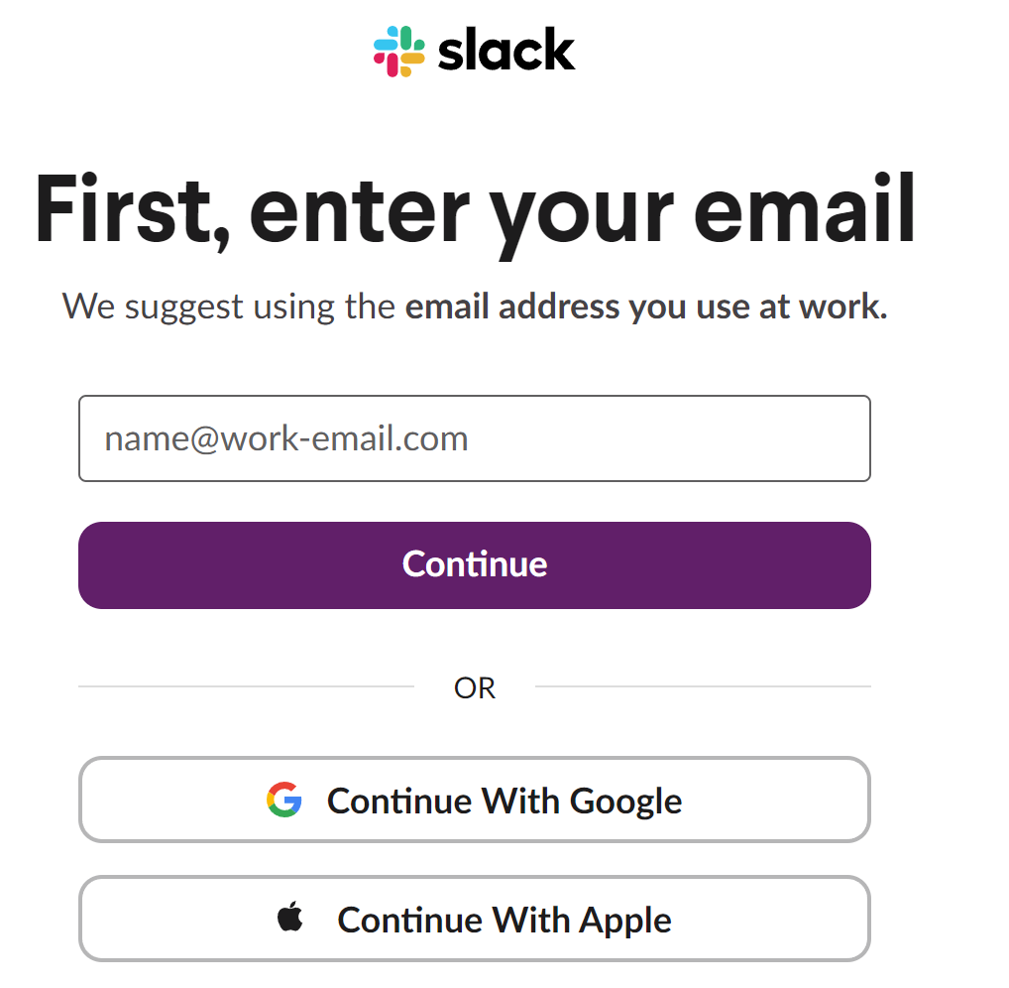
Creating a Workspace

Slide 9
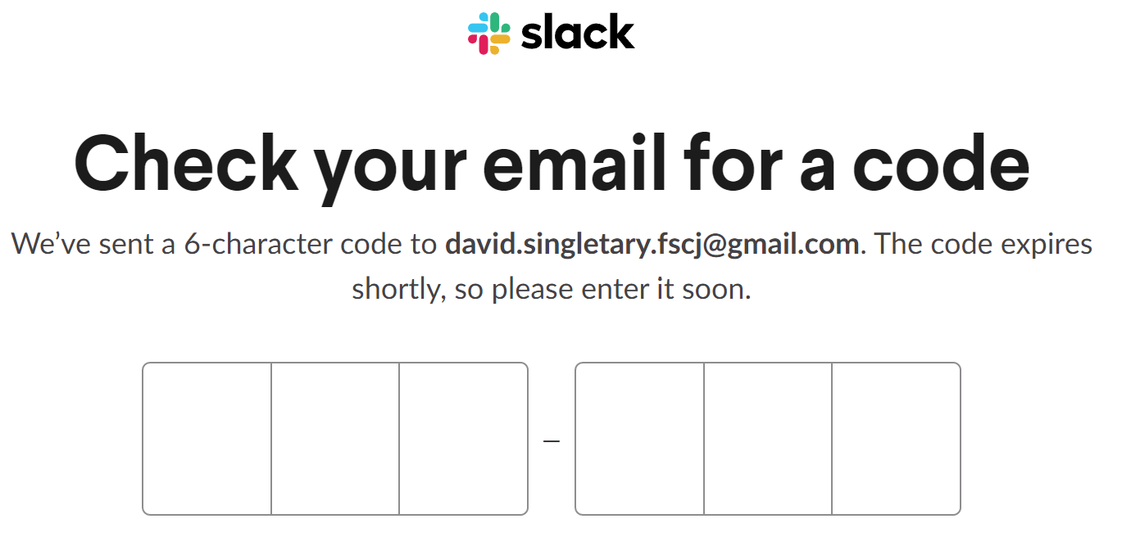
Creating a Workspace

Slide 10
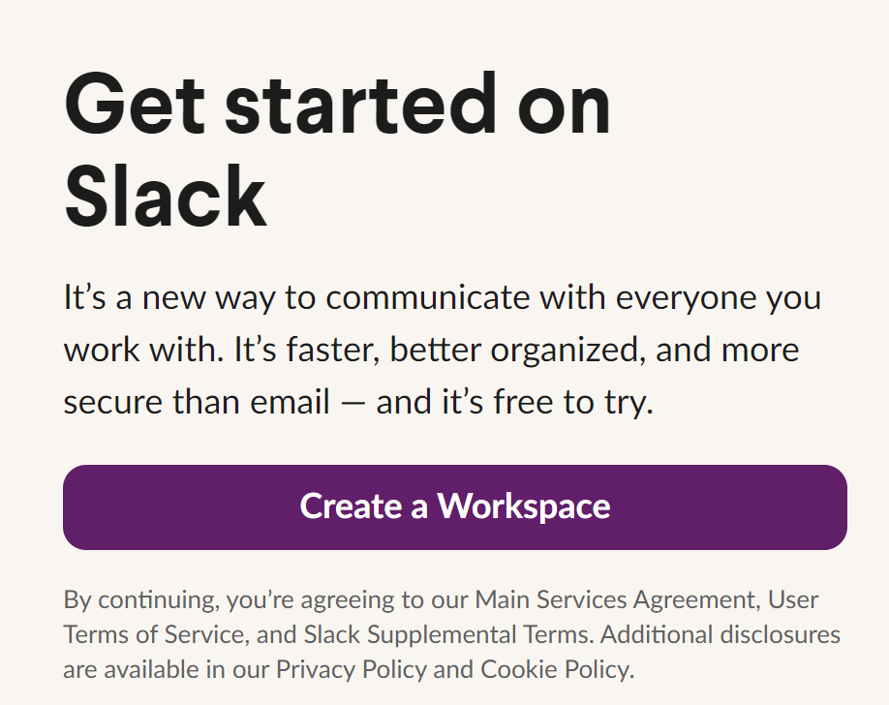
Creating a Workspace

Slide 11
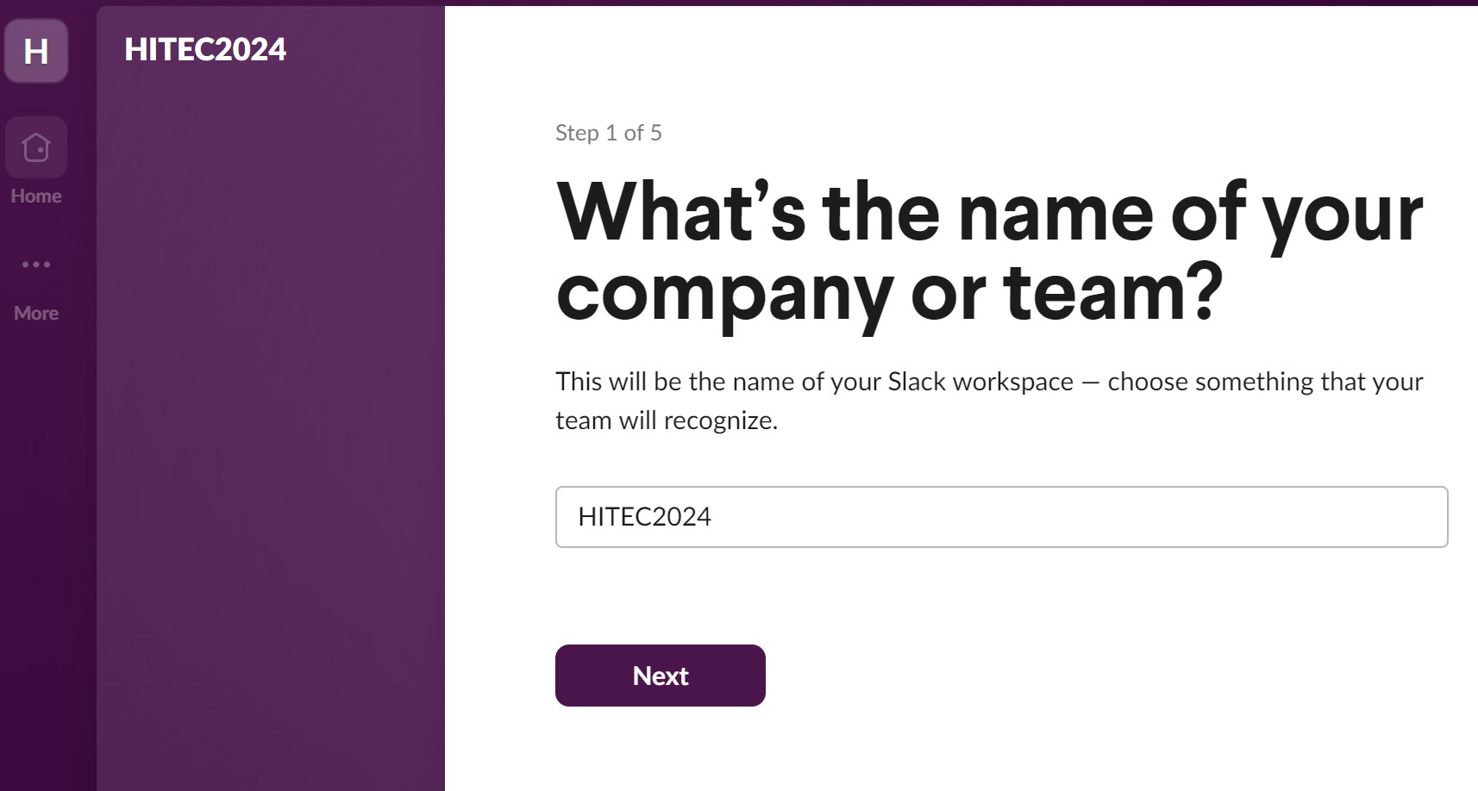
Creating a Workspace

Slide 12
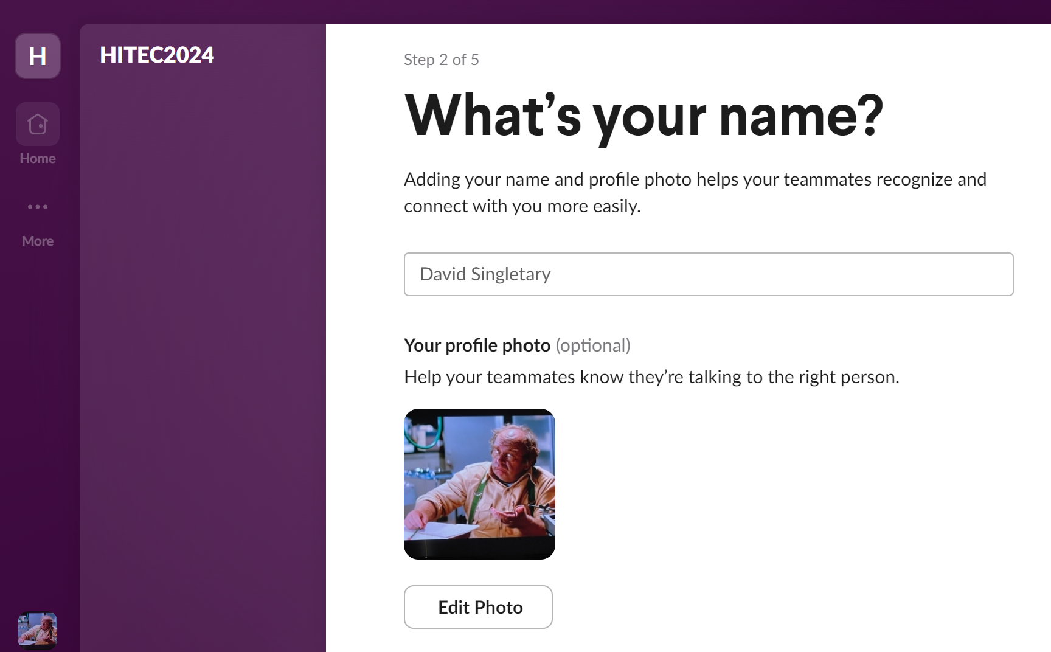
Creating a Workspace

Slide 13
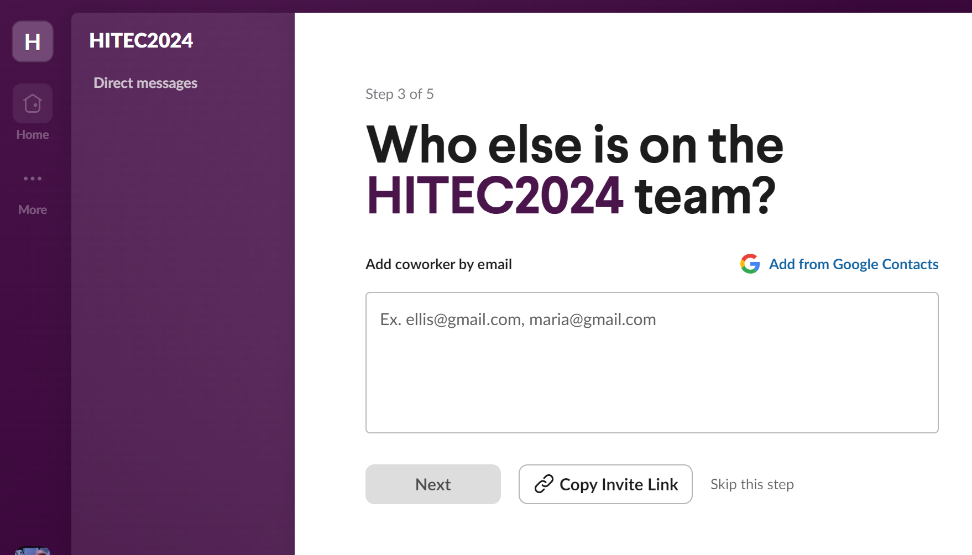
Creating a Workspace

Slide 14
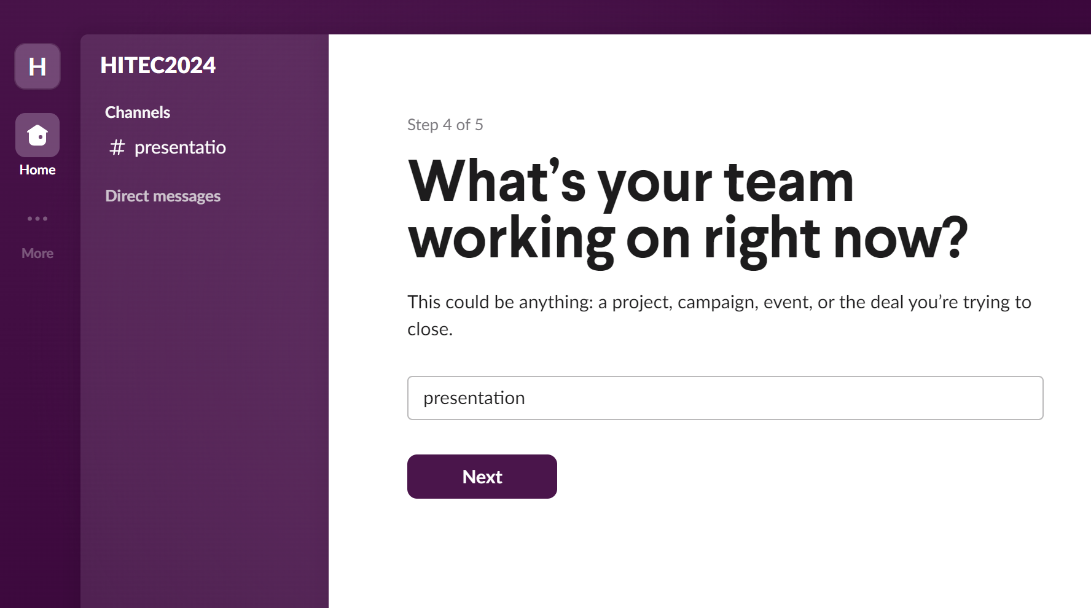
Creating a Workspace

Slide 15
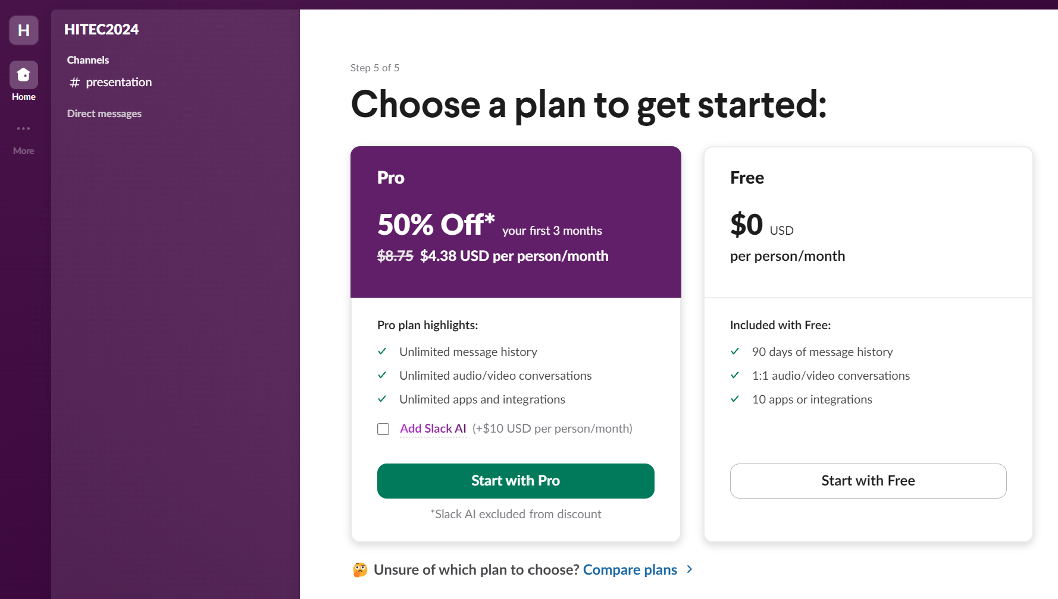
Creating a Workspace

Slide 16
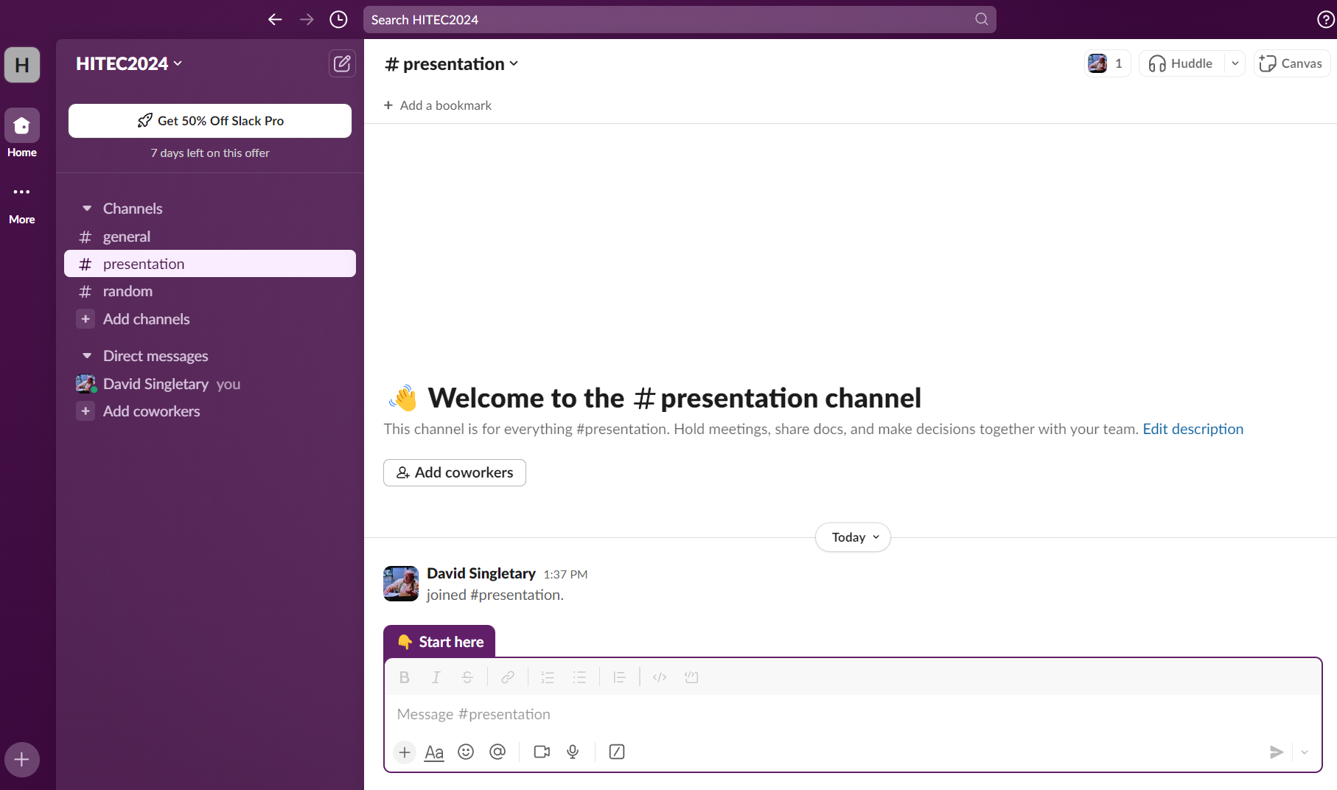
Creating a Workspace

Slide 17
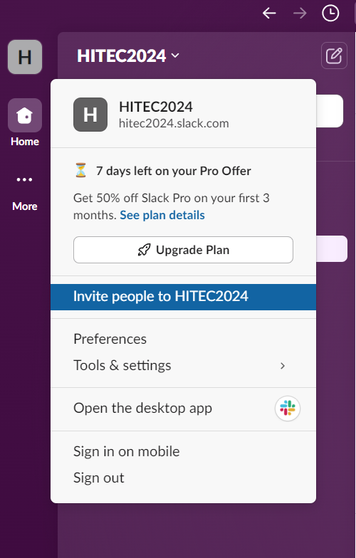
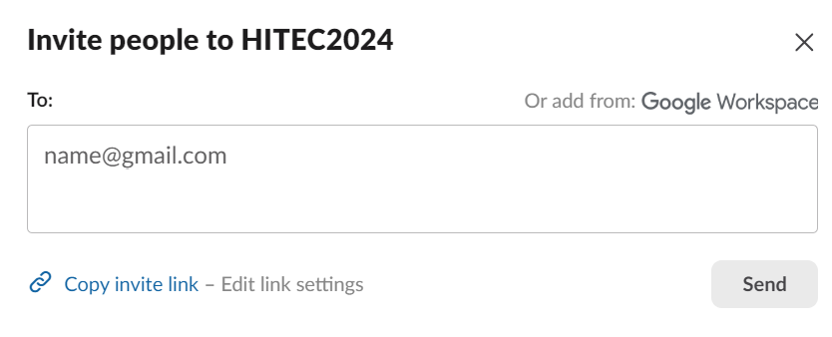
Creating a Workspace
https://join.slack.com/t/hitec2024/shared_invite/zt-2nt8u278z-PgyS8xPO8rDexvKdbFtAXQ

Slide 18
Organizing the Workspace
Dedicated workspaces for individual courses ("v1")
Shared workspace per semester ("v2"), one channel per course e.g.,
Summer 2024
# general - all students are members; shared general content
# random - all students are members; "fun" content (memes)
# COP2800C - course-specific channel, restricted membership
# CEN3330C - course-specific channel, restricted membership
# CEN4025C - course-specific channel, restricted membership
...
NOTE: some lower-level courses are excluded from shared workspaces to avoid distractions for first-time college students

Slide 19
Organizing the Workspace

Slide 20
Administering the Workspace
Instructors are workspace creators w/full admin rights
Can delete posts if necessary

Slide 21
Syllabus (Technology Requirements)
Slack
We will collaborate using Slack, an industry-standard collaboration tool. Slack is free (disregard their prompting to upgrade to the paid version, we do not use it). Instructions for joining the Slack workspace and course channel will be provided in Canvas. Slack runs on Windows and Mac (https://slack.com/downloads)

Slide 22
LMS e.g., Canvas Announcement
Slack Workspace Invitation
Here is the invite link for our Slack workspace:
https://join.slack.com/t/summer24-workspace/shared_invite/...
You can download Slack for Windows here: https://slack.com/downloads/windows You can download Slack for Mac here: https://slack.com/downloads/mac There is also a Slack app for iOS and Android devices.
If you haven't used Slack before, each workspace contains channels for discussion topics.
The workspace has a dedicated channel for this course: #cop3330c
We also have a #general channel for general IT questions and discussions. This channel is shared among many other courses that are running this semester.
The #random channel is for fun stuff: technology memes, personal/job announcements, etc. that you would like to share with the class.
All Slack posts must remain family-friendly. Be respectful. Do not DM without consent from the recipient. Do not share code solutions for course assignments before the due date, but feel free to share ideas, hints, and algorithms.

Slide 23
Student Experience (Kate Araya)
Survey Questions
While we conducted a survey with a total of eight questions to understand students’ experiences with Slack, our primary focus was on identifying the specific benefits students feel Slack provides. Here are two key questions from the survey:
How has your educational experience benefited from using Slack?
Do you feel Slack could continue to be beneficial to you after graduation, perhaps in a professional setting?

Slide 24
How did you first hear of Slack?
Within the last year
More than a year ago
More than 3 years ago.
More than 5 years ago.
How did you communicate with your professors and fellow classmates prior to using Slack?
1) School email
2) Via Canvas
3) Via scheduled meetings with profs
4) Social media, personal emails and/ or phone numbers to contact fellow classmates
5) I have never communicated with professors or fellow students outside designated assignments/discussions.

Slide 25
How has your educational experience benefited from using Slack?
(Please select all that apply from the following):
Productivity
communication skills
Collaborating
assignment experience
soft-skills
timely responses to questions
feeling of community
other: ________
no perceived benefits
4) How quickly were you able to learn how to use Slack?
1) Within a day
2) Took me a while to get a hang of it
3) Still trying to figure it out

Slide 26
5) What elements of Slack are the most/least important to you?
6) What, if anything, is has been the most frustrating part about
using Slack?
7) Did you find the navigation menu intuitive and easy to understand?
Yes
No
Could be easier
8) Do you feel Slack could continue to be beneficial to you after graduation, perhaps in a professional setting?
Yes 3) I already use it in my profession
No
­

Slide 28
More than half of the respondents found Slack beneficial across various value data points.
Notably, the lowest added benefit identified was “Assistance with Assignments,” is subjective and could be interesting to explore further through a query comparing “Ask” versus “Response.”
Regarding Collaboration, it might be valuable to conduct a more focused query to assess a student’s Slack presence, comfort in asking for help, and comfort in responding.

Slide 29
Focusing on soft skills, our survey revealed that three out of ten students did not perceive soft skills as an added benefit of using Slack.
This is an intriguing response, as many students without professional work experience may not fully understand the term “soft skills” or recognize their importance for career growth.
By adhering to social and school constructs and codes of conduct, students are practicing these skills daily.
As we progress in our careers, often without direct communication, hiring managers are increasingly focusing on the soft skills of potential candidates, which could significantly impact their employability.

Slide 30
This brings us to why Slack can be essential for students.
Team-building and collaboration, practicing professionalism, properly asking technical questions, or overcoming obstacles and seeking guidance are all skills that will be valuable in our careers post-graduation.
While we and many professionals in our field may be geographically dispersed, gaining a sense of community through collaboration on various projects helps mitigate the sense of isolation often experienced by technology professionals.
With a tool like Slack in education, we can develop more experienced students with better communication and productivity skills, leading to improved data and technology outcomes.

Slide 31
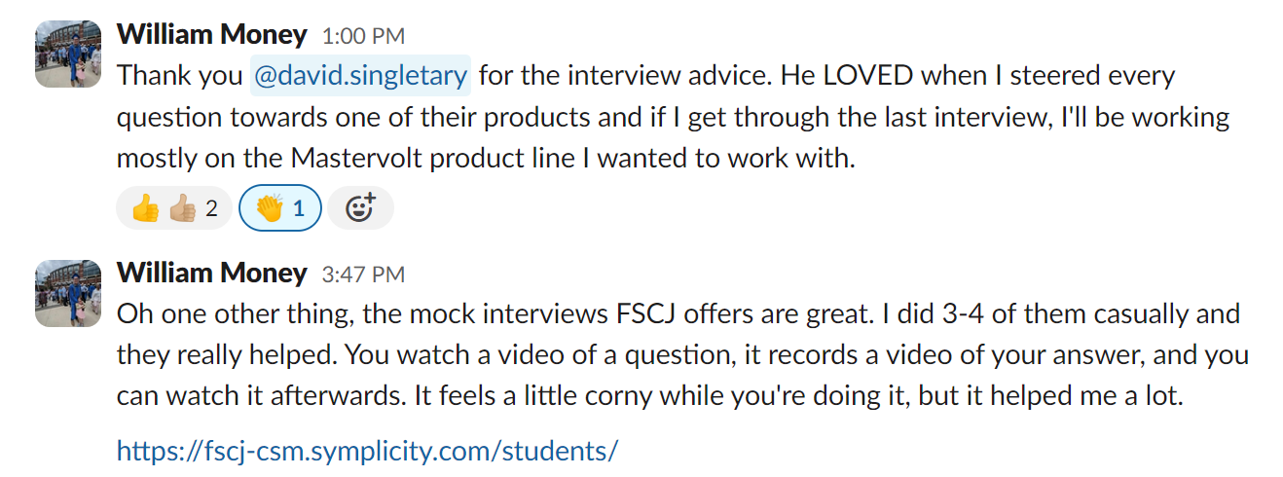
Instructor Perspective (Pamela Brauda)
Students get to share great advice and endorsements across classes

Slide 32
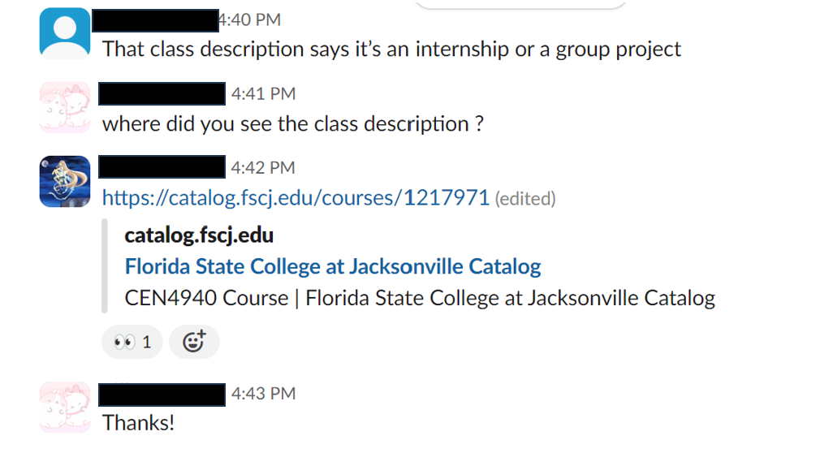
Instructor Perspective
Students give and get information about school from each other

Slide 33
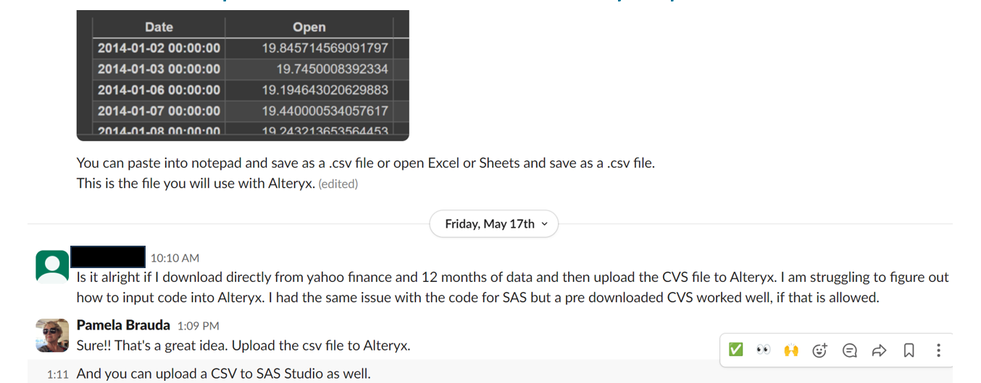
Instructor Perspective
Students who join a class channel can see feedback and assistance for other student's questions – screenshots are easy to paste.

Slide 34
Instructor Perspective
Slack is easier to use on a mobile phone or tablet
Lower authentication thresholds
Easier to add attachments, photos, screenshots
Lightweight feeling compared with traditional email, less formal
Students see how professionals communicate in a work setting
It feels good to get feedback from others, even if it's just a ☺ or 

Slide 35
Instructor Perspective
Students encourage and support each other during difficult times

Slide 36
Student Experience (Steven Gsell)
Yes, it sounds just like the animal!
Current FSCJ student pursuing B.A.S in Computer Information Systems
Focus on software development
Been using Slack in multiple classes throughout education at FSCJ
Observed how Slack can add cohesion of communication in groups

Slide 37
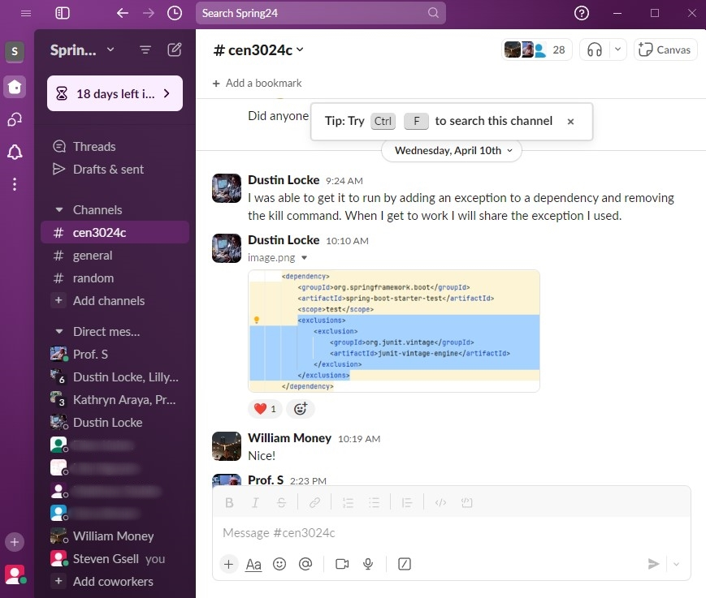
Allows for Group Problem Solving
Software projects in a class setting can be chaotic without clear communication
We are all learning and perhaps working with several new technologies for the first time. We are also learning HOW to learn in a fast-paced tech environment.
When our groups run into problems, Slack allows us to pinpoint the problem as a group and see the clear solution when someone finds it!
Notes:
Software projects in a class setting can be chaotic without clear communication
We are all learning and perhaps working with several new technologies for the first time. We are also learning HOW to learn in a fast-paced tech environment.
When our groups run into problems, Slack allows us to pinpoint the problem as a group and see the clear solution when someone finds it!
(Dustin was able to pinpoint a problem with our Spring-Boot API and share what he found with our group. It was part of a dependency that we could manually exclude.)

Slide 38
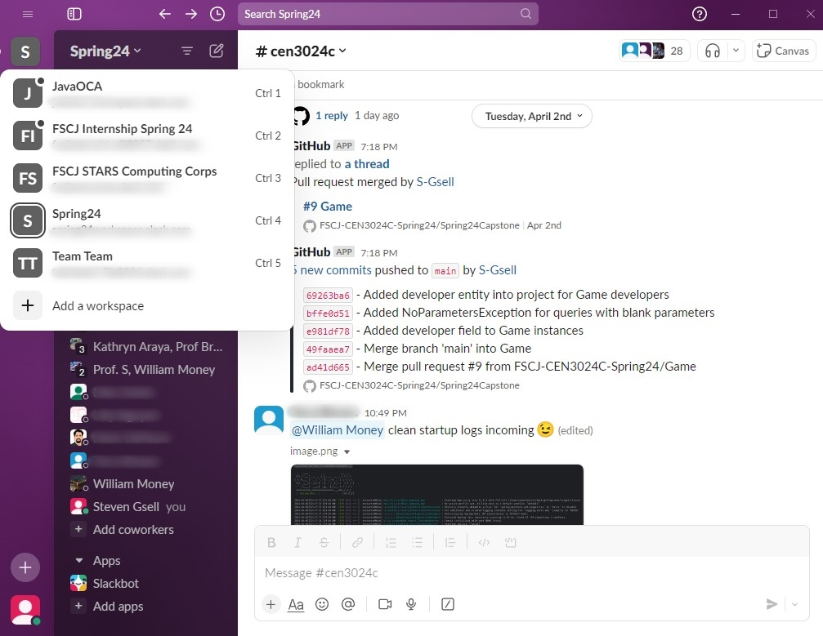
Allows Organized Group Separation
Juggling different groups can quickly become a chore without the proper tools.
Slack allows you to have multiple workspaces at once, with a user-friendly UI to jump between all your groups.
Having clearly defined workspaces allows for easy transitioning from one group to another.
Notes:
Juggling different groups can quickly become a chore without the proper tools.
Slack allows you to have multiple workspaces at once, with a user-friendly UI to jump between all your groups.
Having clearly defined workspaces allows for easy transitioning from one group to another.
(At FSCJ it can get to be a little much if you are taking multiple IT classes at the same time. Slack allows a handy workspace system to jump between your groups of peers.)

Slide 39
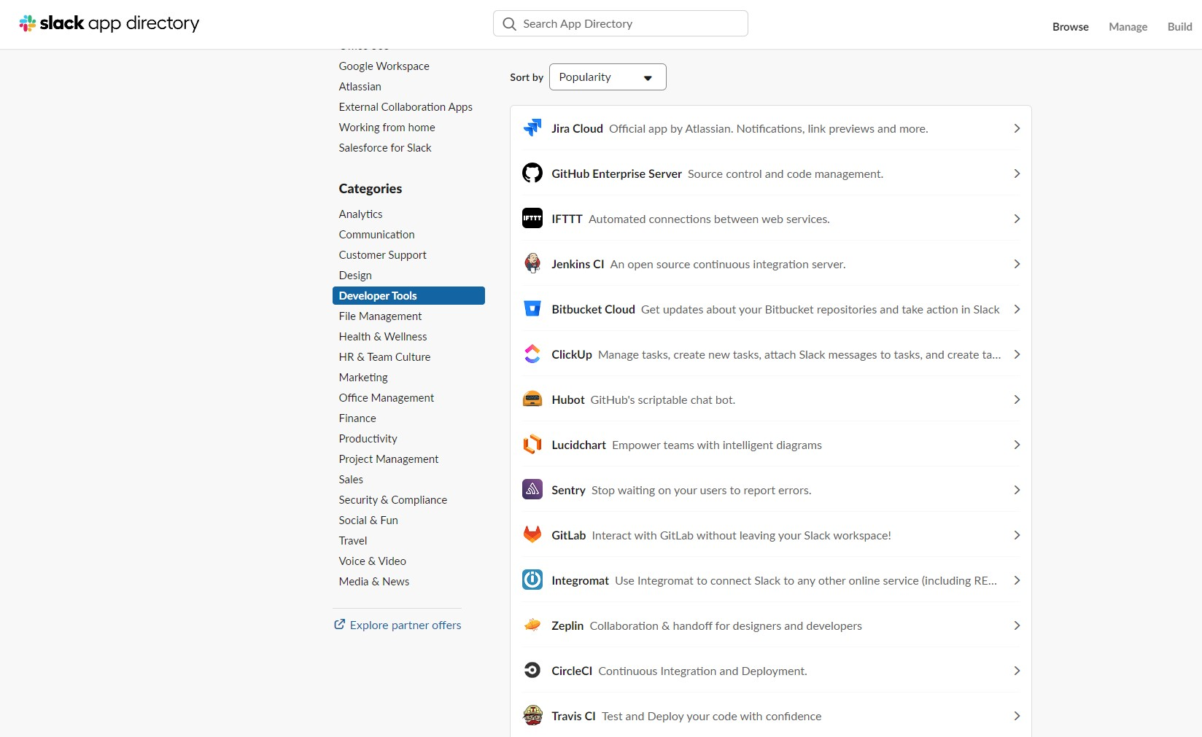
Allows Communication Customization
One of the most noticeable things about Slack is the customization that is possible through their add-on apps!
There are thousands of useful apps that can be added to a Slack workspace that supports the task your group is trying to accomplish.
This customization allows for adaptation to different technologies and for an ever-changing Agile environment.
https://slack.com/apps
Notes:
One of the most noticeable things about Slack is the customization that is possible through their add-on apps!
There are thousands of useful apps that can be added to a Slack workspace that supports the task your group is trying to accomplish.
This customization allows for adaptation to different technologies and for an ever-changing Agile environment.

Slide 40
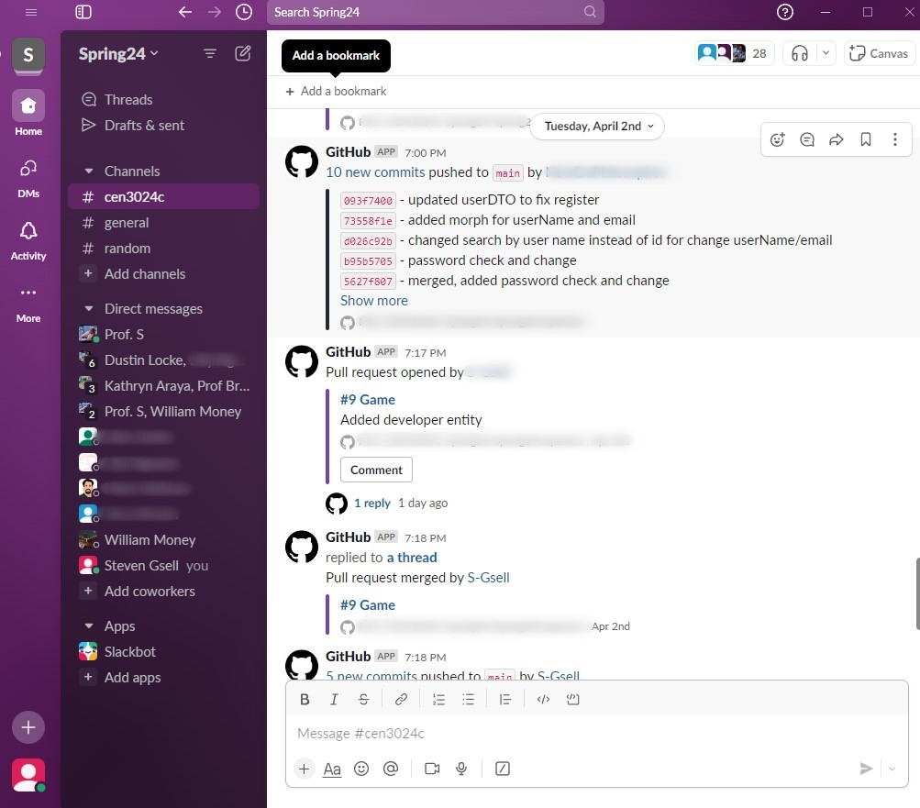
Allows Repository Transparency
Some of our groups have utilized the GitHub plugin for Slack. This allows the group to be up to date with every update and change happening.
This allows cohesion of progress updates when the group reconvenes to discuss the next steps!
No matter what you are teaching, there will almost certainly be an add-on that can help your group setting.
Notes:
How often have you gone to push your code only to see that you need to pull the new updated first?
Some of our groups have utilized the GitHub plugin for Slack. This allows the group to be up to date with every update and change happening.
This allows cohesion of progress updates when the group reconvenes to discuss the next steps!

Slide 41
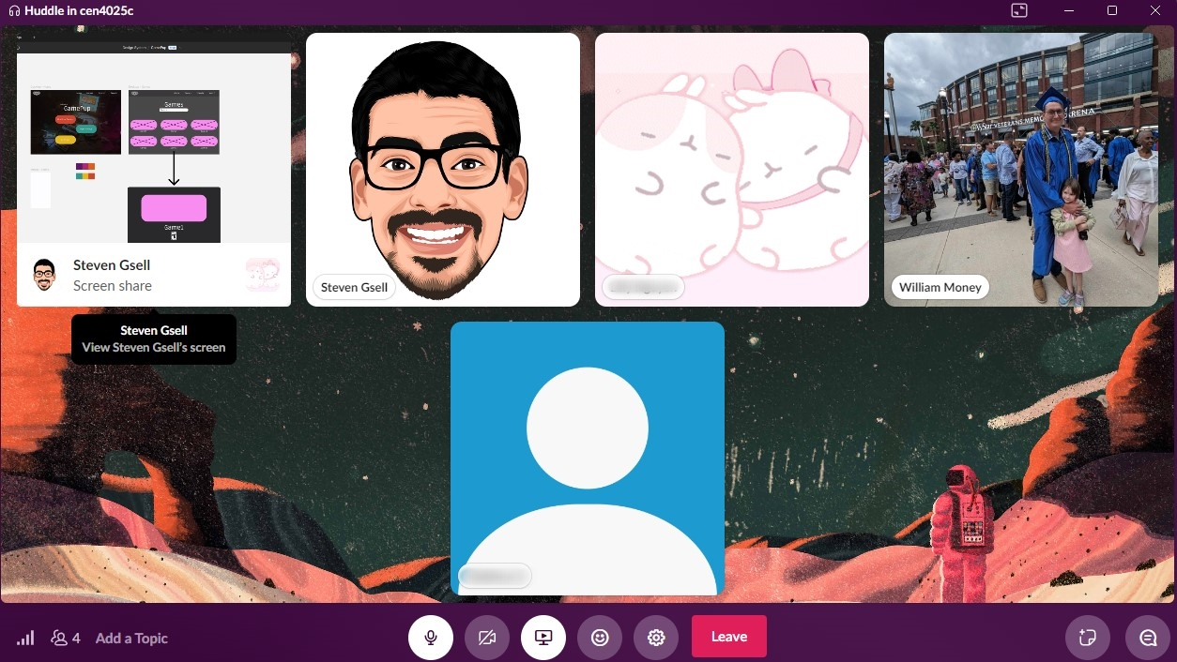
Enhances Cohesive File & Screen Sharing
By utilizing the Slack Huddle feature our groups are able to have a live collaboration on demand.
If there is any confusion to the project at hand there can be clarification in the matter of seconds!
The cliché goes that a picture speaks a thousands words. So 30fps screen sharing should speak about 30,000 words per second. (pause for cheesy joke laughter)
Notes:
By utilizing the Slack Huddle feature our groups are able to have a live collaboration on demand.
If there is any confusion to the project at hand there can be clarification in the matter of seconds!
The cliché goes that a picture speaks a thousands words. So 30fps screen sharing should speak about 30,000 words per second. (pause for laughter)

Slide 42
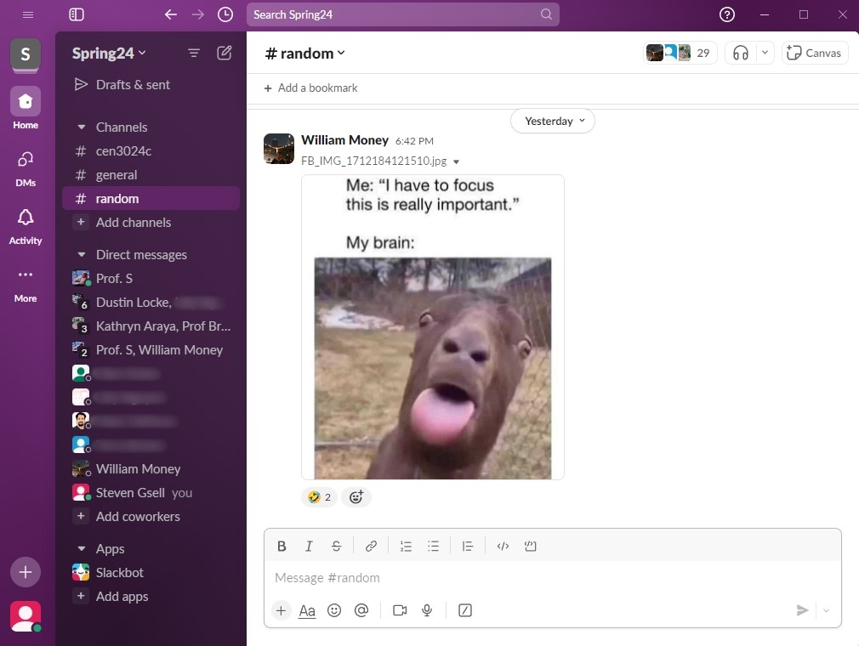
Supports community and friendship
Sometimes our computer notifications can cause a bit of a stressful spike in our bodies when we hear that jingle or notification noise.
In a healthy group setting, those notifications can perk you up and bring motivation to your work-flow!
Efficiency is always important, especially in the tech world. However, we find our group is most efficient when we are all laughing with each other.
Notes:
Sometimes our computer notifications can cause a bit of a stressful spike in our bodies when we hear that jingle or notification noise. (pop pop pop brush brush brush)
In a healthy group setting, those notifications can perk you up and bring motivation to your work-flow!
Efficiency is always important, especially in the tech world. However, we find our group is most efficient when we are all laughing with each other.

Slide 43

Thank you!
David Singletary David.Singletary@fscj.edu
Pamela Brauda Pamela.Brauda@fscj.edu
Steven and Kathryn
https://bit.ly/4drdRs7
https://github.com/FSCJ-FacultyDev/HITEC2024.git

